Slide 1
PREDICTIVE MAINTENANCE OF Industrial machinery using ML
CAPSTONE PROJECT
Presented By:
1. Tejas Kumar V-Malla Reddy Institute of Technology and Science-CSE

Slide 2
OUTLINE
Problem Statement (Should not include solution)
Proposed System/Solution
System Development Approach (Technology Used)
Algorithm & Deployment
Result (Output Image)
Conclusion
Future Scope
References

Slide 3
Problem Statement
Develop a predictive maintenance model for a fleet of industrial machines to anticipate failures before they occur. This project will involve analyzing sensor data from machinery to identify patterns that precede a failure. The goal is to create a classification model that can predict the type of failure (e.g., tool wear, heat dissipation, power failure) based on real-time operational data. This will enable proactive maintenance, reducing downtime and operational costs.

Slide 4
Proposed Solution
To develop a predictive maintenance model using machine learning that classifies industrial machine failure faults using provided dataset. This model will involve analyzing sensor data from machinery to identify patterns of temperature that can help to predict the type of failure (e.g., tool wear, heat dissipation, power failure) based on real-time operational data. This model will enable proactive maintenance, reducing downtime and operational costs.
Data Collection:
Use the dataset of predictive maintenance from Kaggle.
Data Preprocessing:
Clean and preprocess the collected data.
Model Training:
Implement a machine learning model using ML algorithms such as Random Forest, SVM etc to predict the type of failures in machines based on the give data.
Train the classification model with the dataset provided.
Deployment:
Deploy the model on IBM cloud which can be accessible through public url provided by IBM cloud.
Evaluation:
Assess the model's performance based on predictions made by the machine learning algorithms like Random Forest, Decision Tree etc.
There will be one algorithm which performs more accurately and gives correct result with good precision.

Slide 5
System Approach
The "System Approach" section outlines the overall strategy and methodology for developing and implementing the rental bike prediction system. Here's a suggested structure for this section:
System requirements:
OS: Windows/Mac
RAM: 4GB or above
Library required to build the model:
IBM Cloud
IBM Watsonx AI Studio service
IBM Watsonx AI Runtime service
IBM Cloud Object Storage service for data storage and handling

Slide 6
Algorithm & Deployment
Algorithm Selection:
Random Forest Classifier is a machine learning algorithm that builds multiple decision trees and merges their results to improve classification accuracy.
Trains multiple decision trees on different random subsets of the data.
It can handle non-linear and high-dimensional data effectively.
It can perform multi-class classification.
Data Input:
The input features used by the algorithm, such as air temperature, process temperature, rotational speed(RPM), torque, tool wear from the dataset.
Training Process:
First create a ML model in IBM Watsonx AI Studio and link it with a cloud object storage and a Runtime service.
Upload the dataset to the model and select the column name which we want to predict, that is Failure Type column Highlight any specific considerations or techniques employed, such as cross-validation or hyperparameter tuning.

Slide 7
Algorithm & Deployment
Then run the model, here the model divides the data into subsets and algorithms work on these subsets which is called multi class classification.
It gives the pipelines made by algorithms in which, one pipeline gave the output with an accuracy of 0.995.
Save that pipeline which can be deployed online for public use.
Prediction Process:
Give the data present in the dataset to the model like air temperature, process temperature, torque, toll wear etc then it predicts the target column i.e. Failure type based on given data.
Deployment process:
After successful execution of model, create a deployment space in Watsonx AI Studio and deploy the model.
After deployment, you get the public and private urls to access the model.

Slide 8
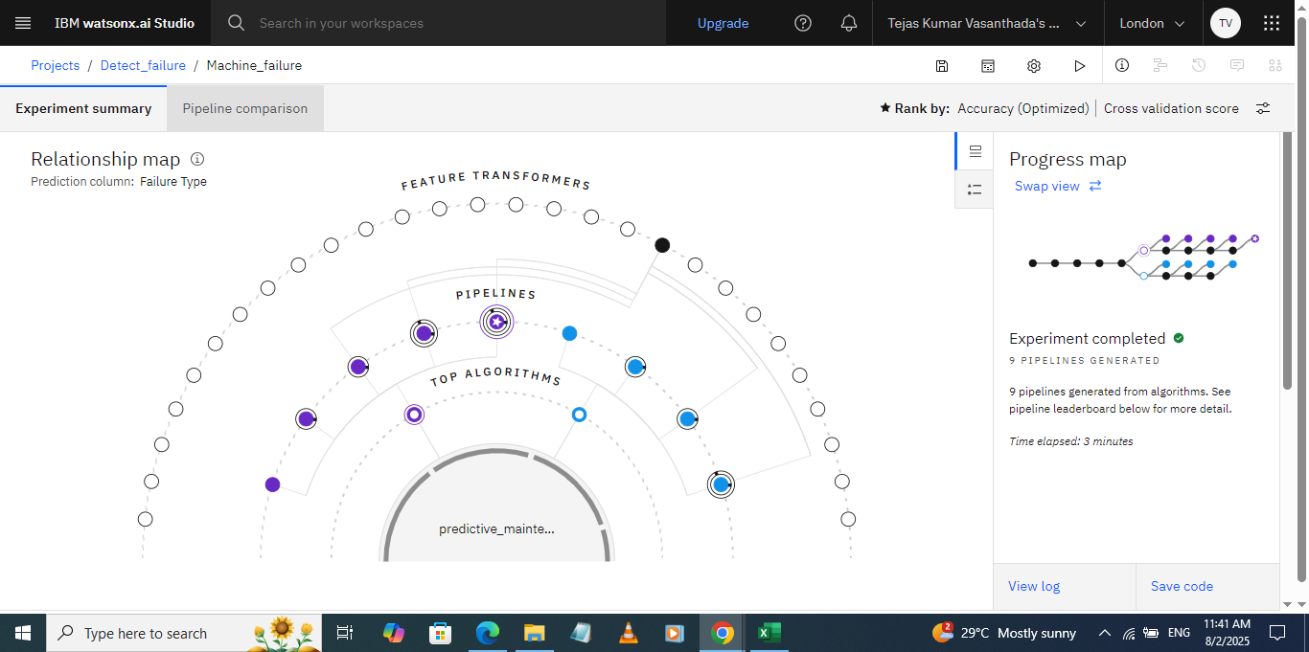
Result
Screenshot 1: Relationship map of ML Model

Slide 9
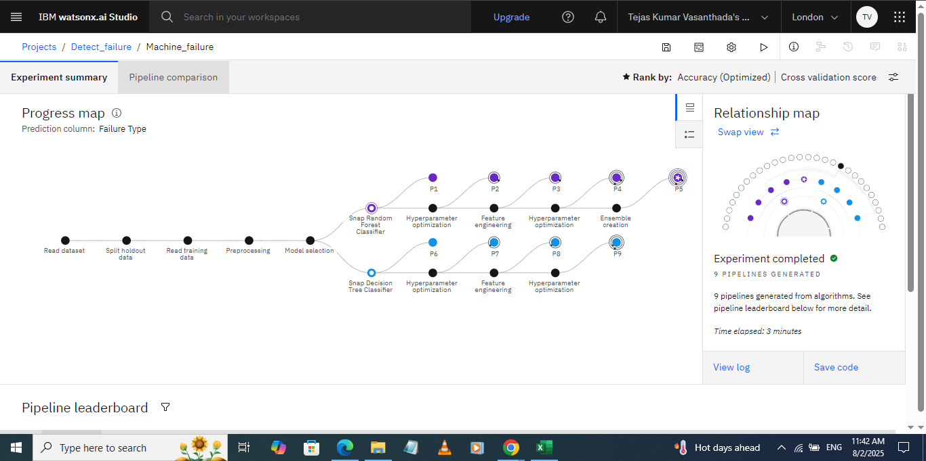
Result
Screenshot 2: Progress map of ML Model

Slide 10
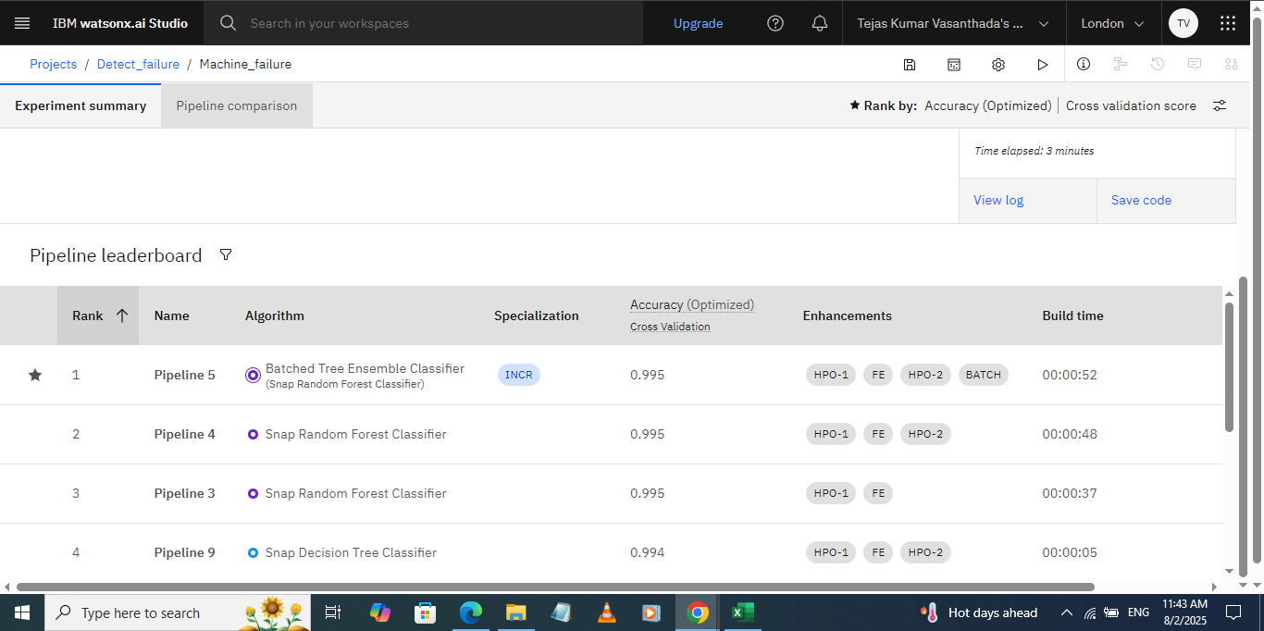
Result
Screenshot 3: Different pipelines of ML Model

Slide 11
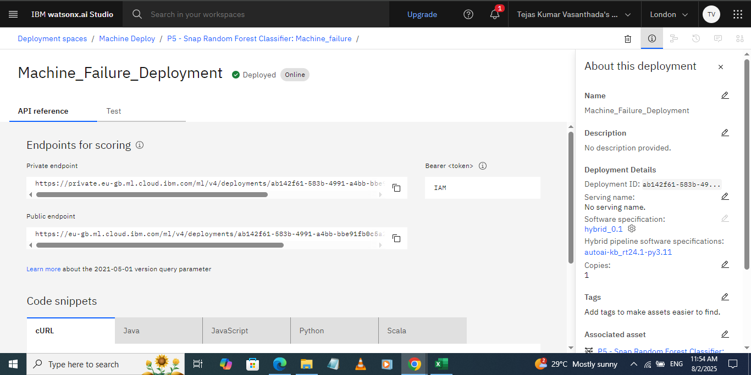
Result
Screenshot 4: Deployed model with API Endpoints

Slide 12
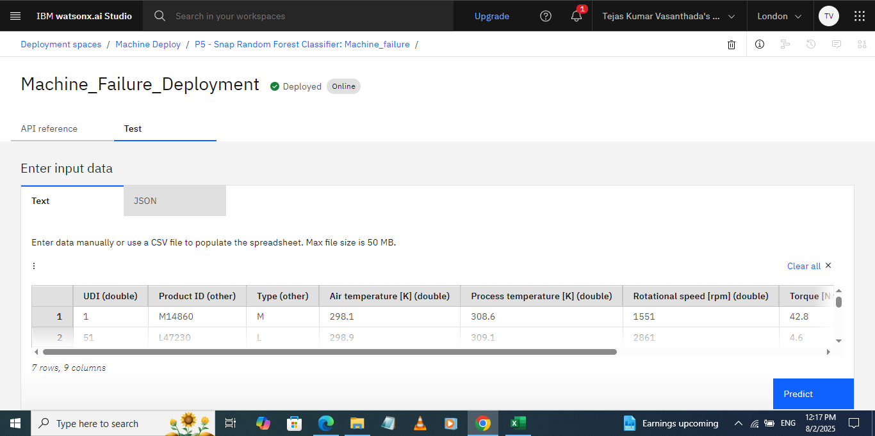
Result
Screenshot 5: Data given to the model

Slide 13
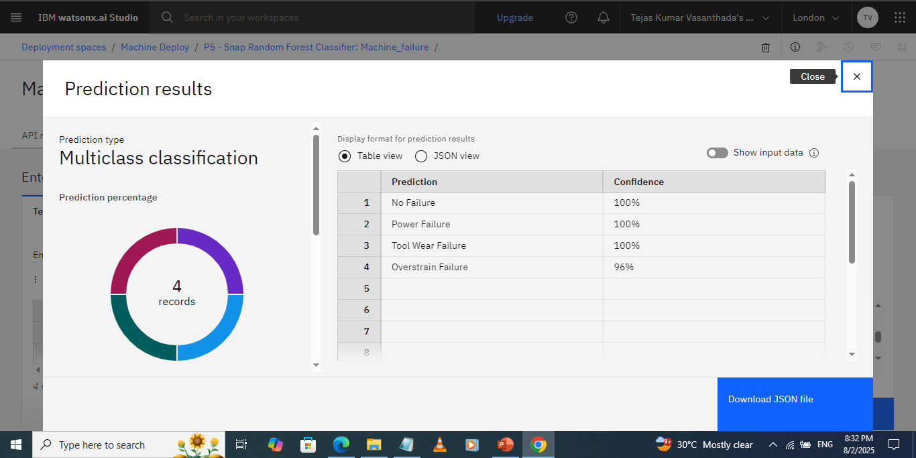
Result
Screenshot 6: Prediction Results of Model

Slide 14
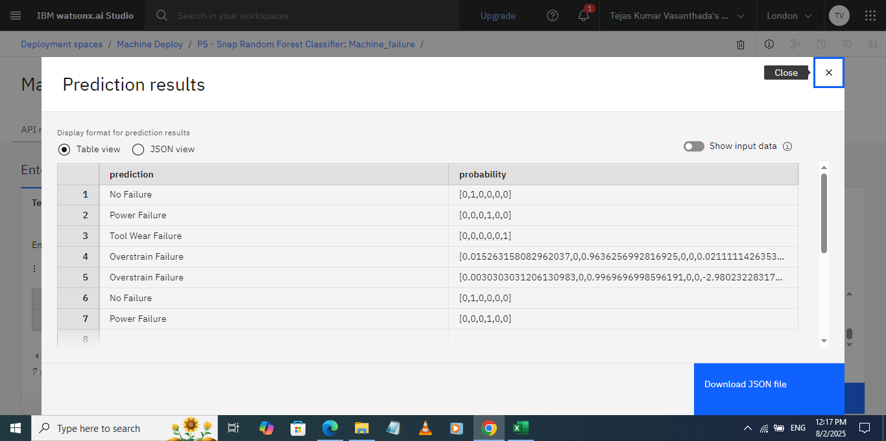
Result
Screenshot 7: Prediction results in Table format

Slide 15
Conclusion
This project gives a way to automate the process of finding the industrial machines which are ready to get failure which helps the industries to identify tool wear early and get repaired or replaced accordingly. As a result it helps firms to work without improper functioning of machines and the machines are maintained properly functionable. With this we can conclude that using AI can help to reduce the work and save the time.

Slide 16
Future scope
This project can be improved by adding other external parameters to dataset like humidity, moisture, rust percentage etc. The details of the repairs done can also be noted for future reference. We can optimize the algorithms to improve the performance by combining two or more algorithms.

Slide 17
References
Data is taken from Kaggle dataset.
Used IBM Cloud as platform for building project.
Utilized the Watsonx AI Studio which provided the hardware and software to develop and deploy the machine learning model.
Cloud Object Storage service is used for dataset storing and handling the data.

Slide 18
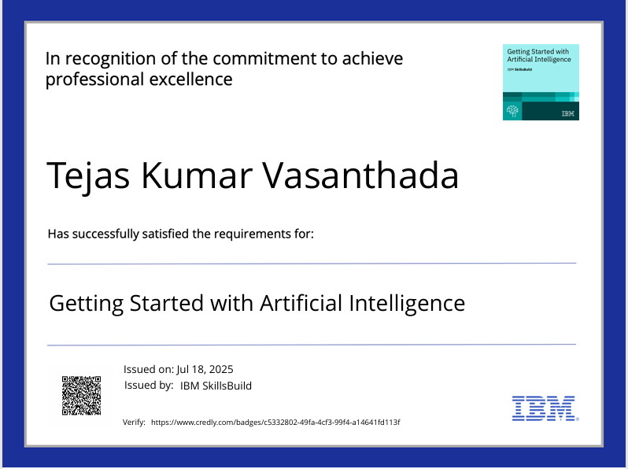
IBM Certifications
Screenshot/ credly certificate( Getting started with AI)

Slide 19
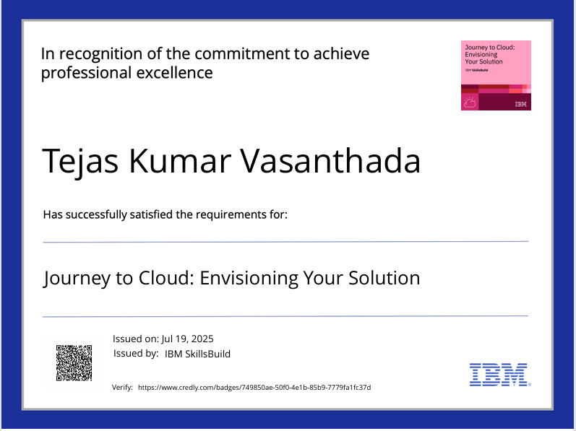
IBM Certifications
Screenshot/ credly certificate( Journey to Cloud)

Slide 20
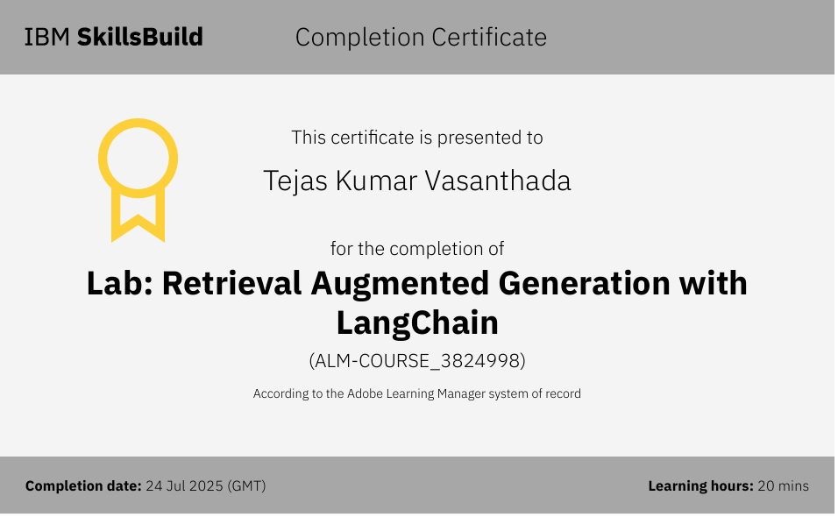
IBM Certifications
Screenshot/ credly certificate( RAG Lab)

Slide 21
THANK YOU

